Slide 1
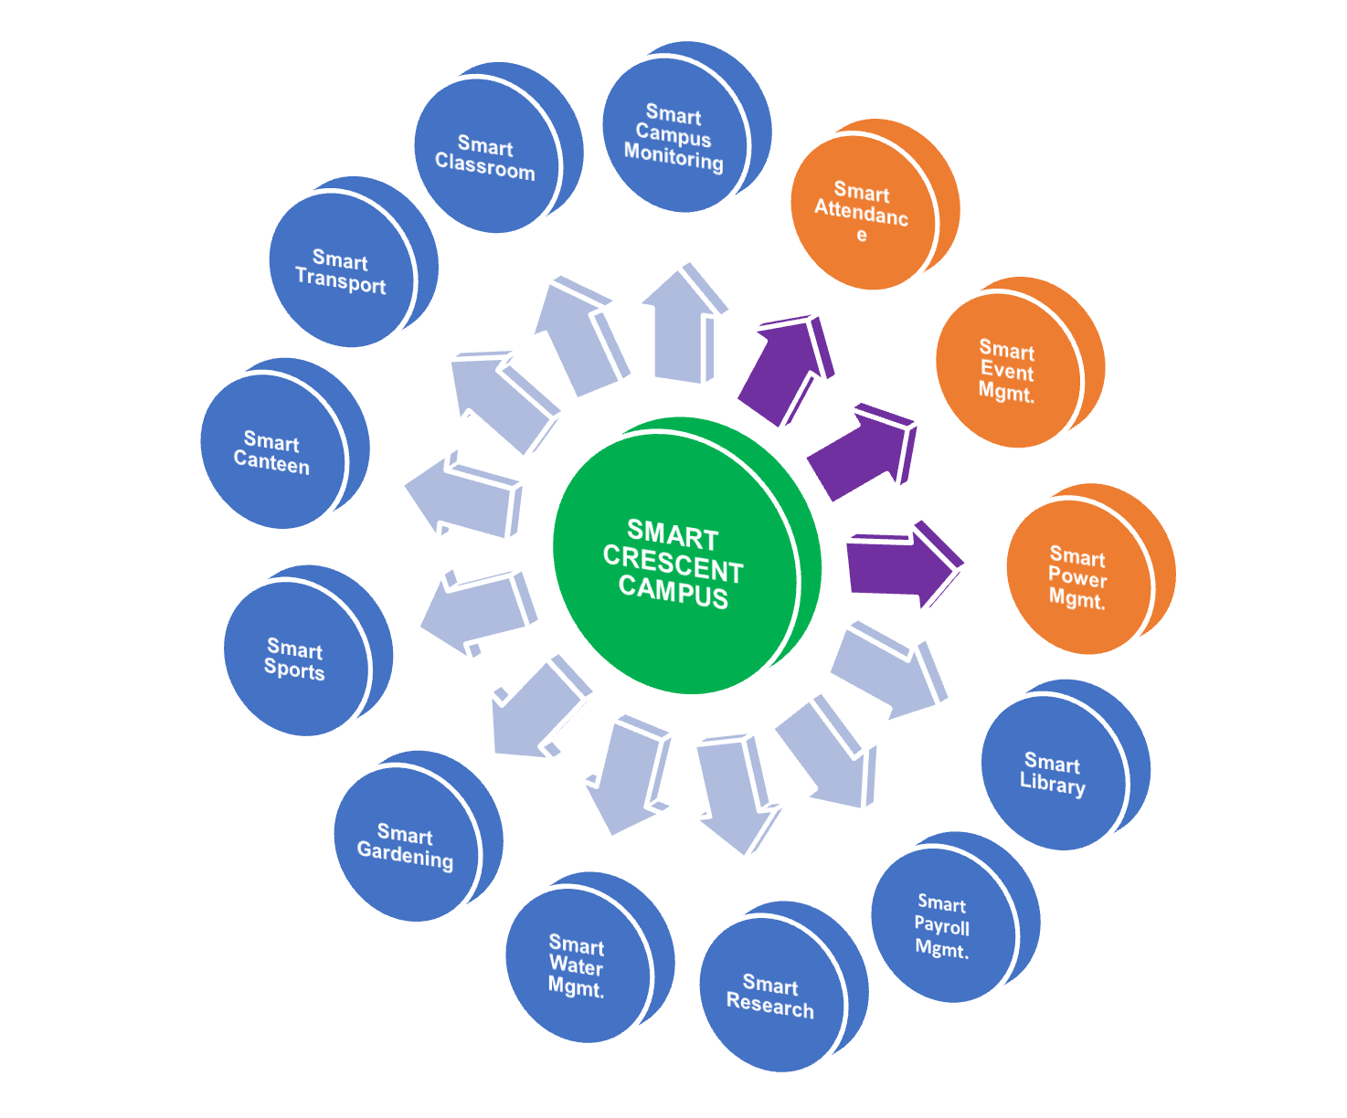

SMART CRESCENT CAMPUS
Module Details:

